Slide 1
Geomagnetic Spectroscopy: An Estimation of Primary Mass of Cosmic Rays
Rajat K Dey^{1,2}
Arunava Bhadra²
Jean-Noël Capdevielle³
¹Department of Physics
²High Energy and Cosmic Ray Research Centre
Univ. of North Bengal, Siliguri
³APC, University of Paris

Slide 2
Introduction
The perpendicular component of the GF causes the trajectories of secondary charged particles to become curved with positive and negative charged particles separating to form an electric dipole moment (Cocconi Phys Rev 1954),
The geomagnetic broadening effect can be non-negligible in compare to the Coulomb scattering.

Slide 3
Some important effects arising out of geomagnetic effect
The separation of electrons and positrons in an EAS by the geomagnetic field is believed to lead the radio emission in EAS (Allan 1970, Colgate 1967).
The geomagnetic field affects the performance of ground-based gamma ray telescope (Hillas 1985, Bowden 1992).

Slide 4
GF induces an azimuthal modulation of the densities of air shower particles, particularly for large angle incidence (Allkofer et al 1985).
The results of large scale anisotropy search by an EAS array will be affected due to GF if not the geomagnetic effect accounted for properly (The Pierre Auger collab., 2011)

Slide 5
Objectives:
To explore whether geomagnetic effect can be utilized to estimate primary mass of cosmic rays.

Slide 6
Primary mass composition from Geomagnetic spectroscopy
The geomagnetic effect is more pronounced in muon component than electrons.
From simulation study it appears that heavy nuclei and proton induced showers may be discriminated from
  i) the ellipticity of lateral muon distribution
  ii) the muon charge ratio (Capdevielle et al 2000)
  iii) the muon dipole moment (Capdevielle, Dey & Bhadra, 2011, 2013)

Slide 7
Simulation procedure adopted
Code: CORSIKA (Heck et al 1998)
Version: 6.970
hadronic interaction models:
High energy - EPOS 1.99
low energy (below 80 GeV/n UrQMD/FLUKA
Curved option for high angle of incidence
kinetic energy thresholds: 3MeV for electrons, 300 MeV for muons

Slide 8
Primaries: Proton and Iron
arriving from different geographical directions: North, East, South, West.
Primary energy (fixed) 1 PeV, 100 PeV

Slide 9
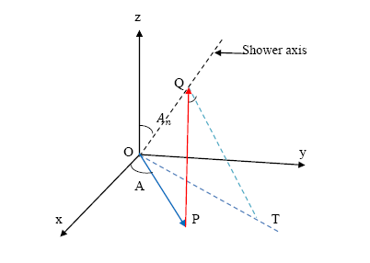


Data analysis:
Correction due to
i) geometric effect ii) attenuation effect

Slide 10
Hypothetical full coverage EAS array of area 300 m x 300 m
Shower core at the centre of the array.

Slide 11
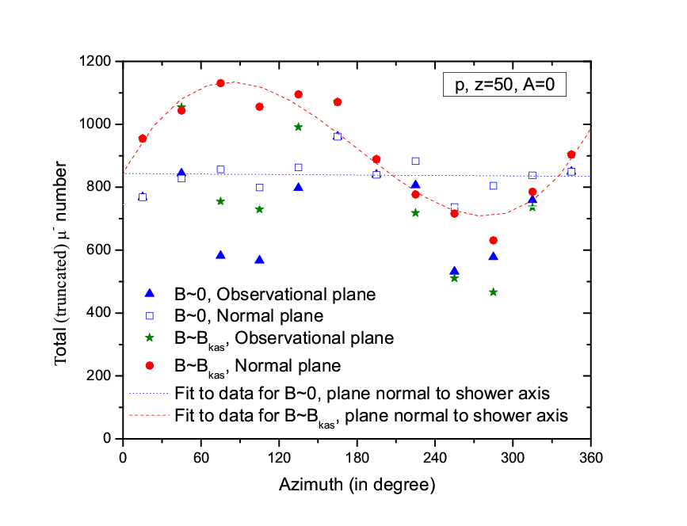
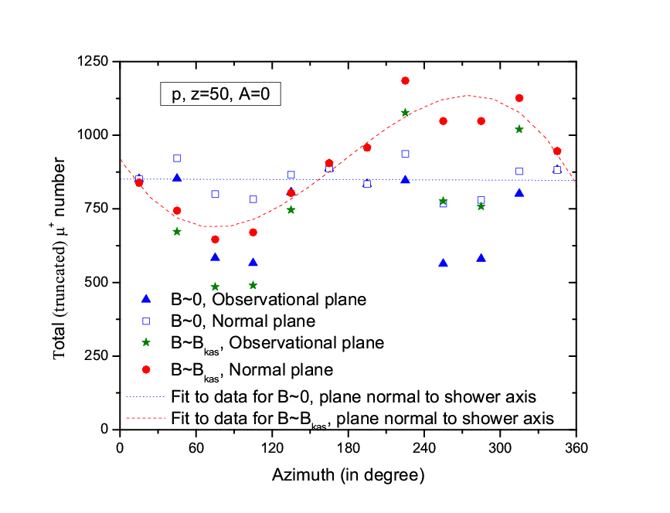
Results:
Azimuthal variation for µ⁺ and µ⁻

Slide 12
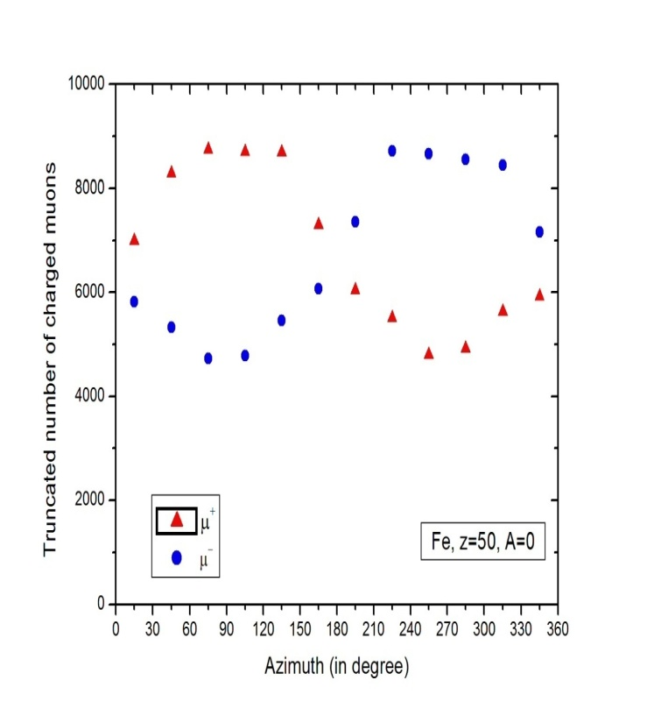
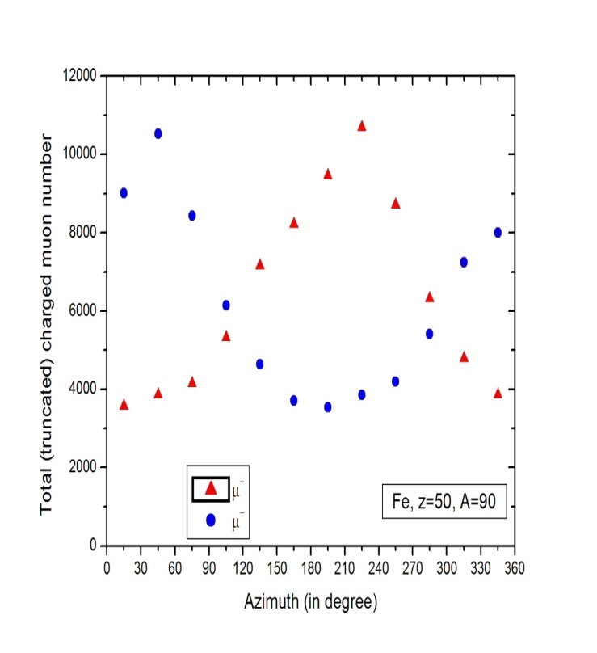
Azimuthal variation of charged muons for Fe primaries
North direction East direction

Slide 13
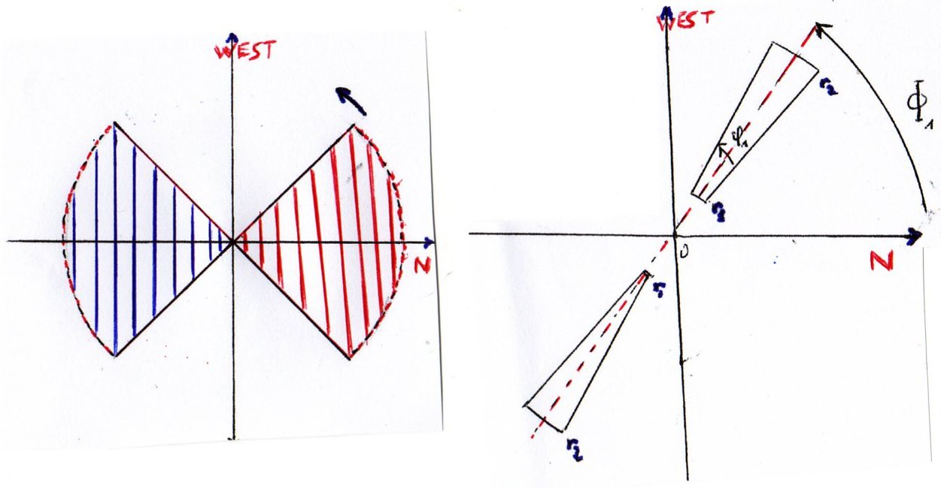
Azimuthal variation of muon dipole length
Butterfly approach

Slide 14
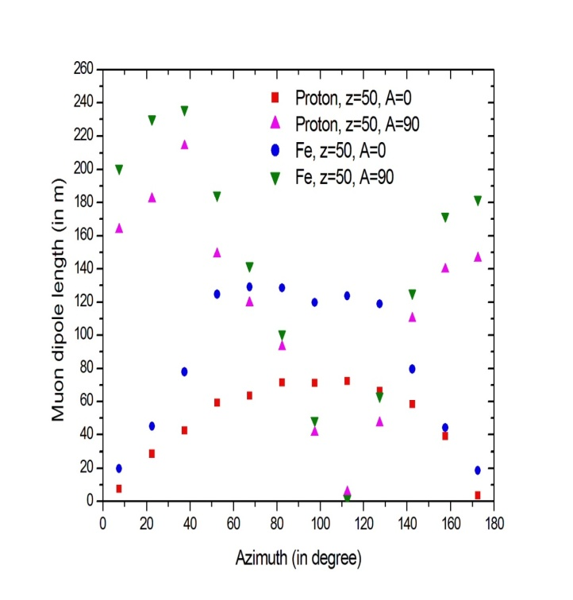

Slide 15
HE muon geomagnetic separation in very inclined EAS p E_{o} = 1 PeV Z = 75°, A= 0° Muon energy > 1 TeV
10 showers from North 10 showers from East

Slide 16
Primary | Θ | φ | N_{µ} | N_{µ} (>1 TeV ) | l(m) | φ₁
P | 75° | 0° | 3160 | 12.5 | 54.6 | 65.8°
P | 75° | 90° | 3000 | 12.2 | 168.0 | 247°
P | 85° | 0° | 12760 | 17.8 | 405.6 | 86.4°
Fe | 65° | 0° | 7137 | 11.1 | 195.24 | 195.24°
Fe | 75° | 0° | 5030 | 19.1 | 81.3 | 84.8°

Slide 17
Geomagnetic separation of µ+, µ- p primary E_{o} = 100 PeV 100 showers from
Z = 75°, A= 0° Muon energy > 5 TeV

Slide 18
Geomagnetic separation µ+, µ-
Fe primary E_{o} = 100 PeV 100 showers from
Z = 75°, A= 0° (North) Muon energy > 5 TeV

Slide 19
Geomagnetic separation of µ+, µ- p primary E_{o} = 100 PeV 100 showers from
Z = 75°, A= 90° Muon energy > 5 TeV

Slide 20
Conclusion
Muon charge ratio in very inclined EAS should give an extra handle for estimating primary mass composition (as well as for testing high energy interaction models).
Experimental realization appears feasible in view of (almost) complete separation of µ+ and µ-
-by large area muon detectors such as ICECUBE.

Slide 21
Thank you

